Slide 1
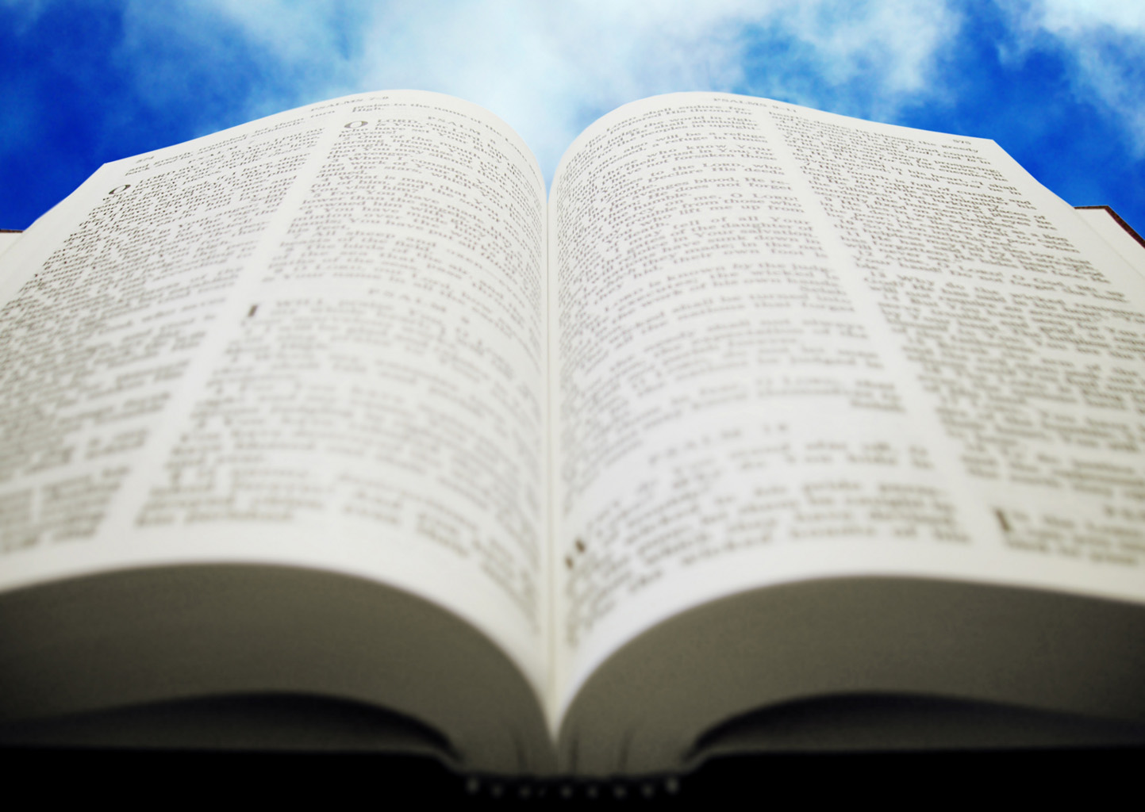
Welcome!
Sunday
Worship 10:00 AM
Sunday
Bible Class (Livestream) 5:00 PM
Wednesday
Bible Class 7:00 PM
www.SunsetchurchofChrist.net

Slide 2
Opening Prayer | Michael Hetzer
Song – 68 | George Watkins
Song – 167 | George Watkins
Lord’s Supper | Craig Foster
Song – 112 | George Watkins
Song – 630 | George Watkins
Lesson | Brian Haines
Song – 268 | George Watkins
Closing | Rob Wade
1 Corinthians 16:2
On the first day of the week let each one of you lay something aside, storing up as he may prosper, that there be no collections when I come.
The collection basket
is in the foyer

Slide 3
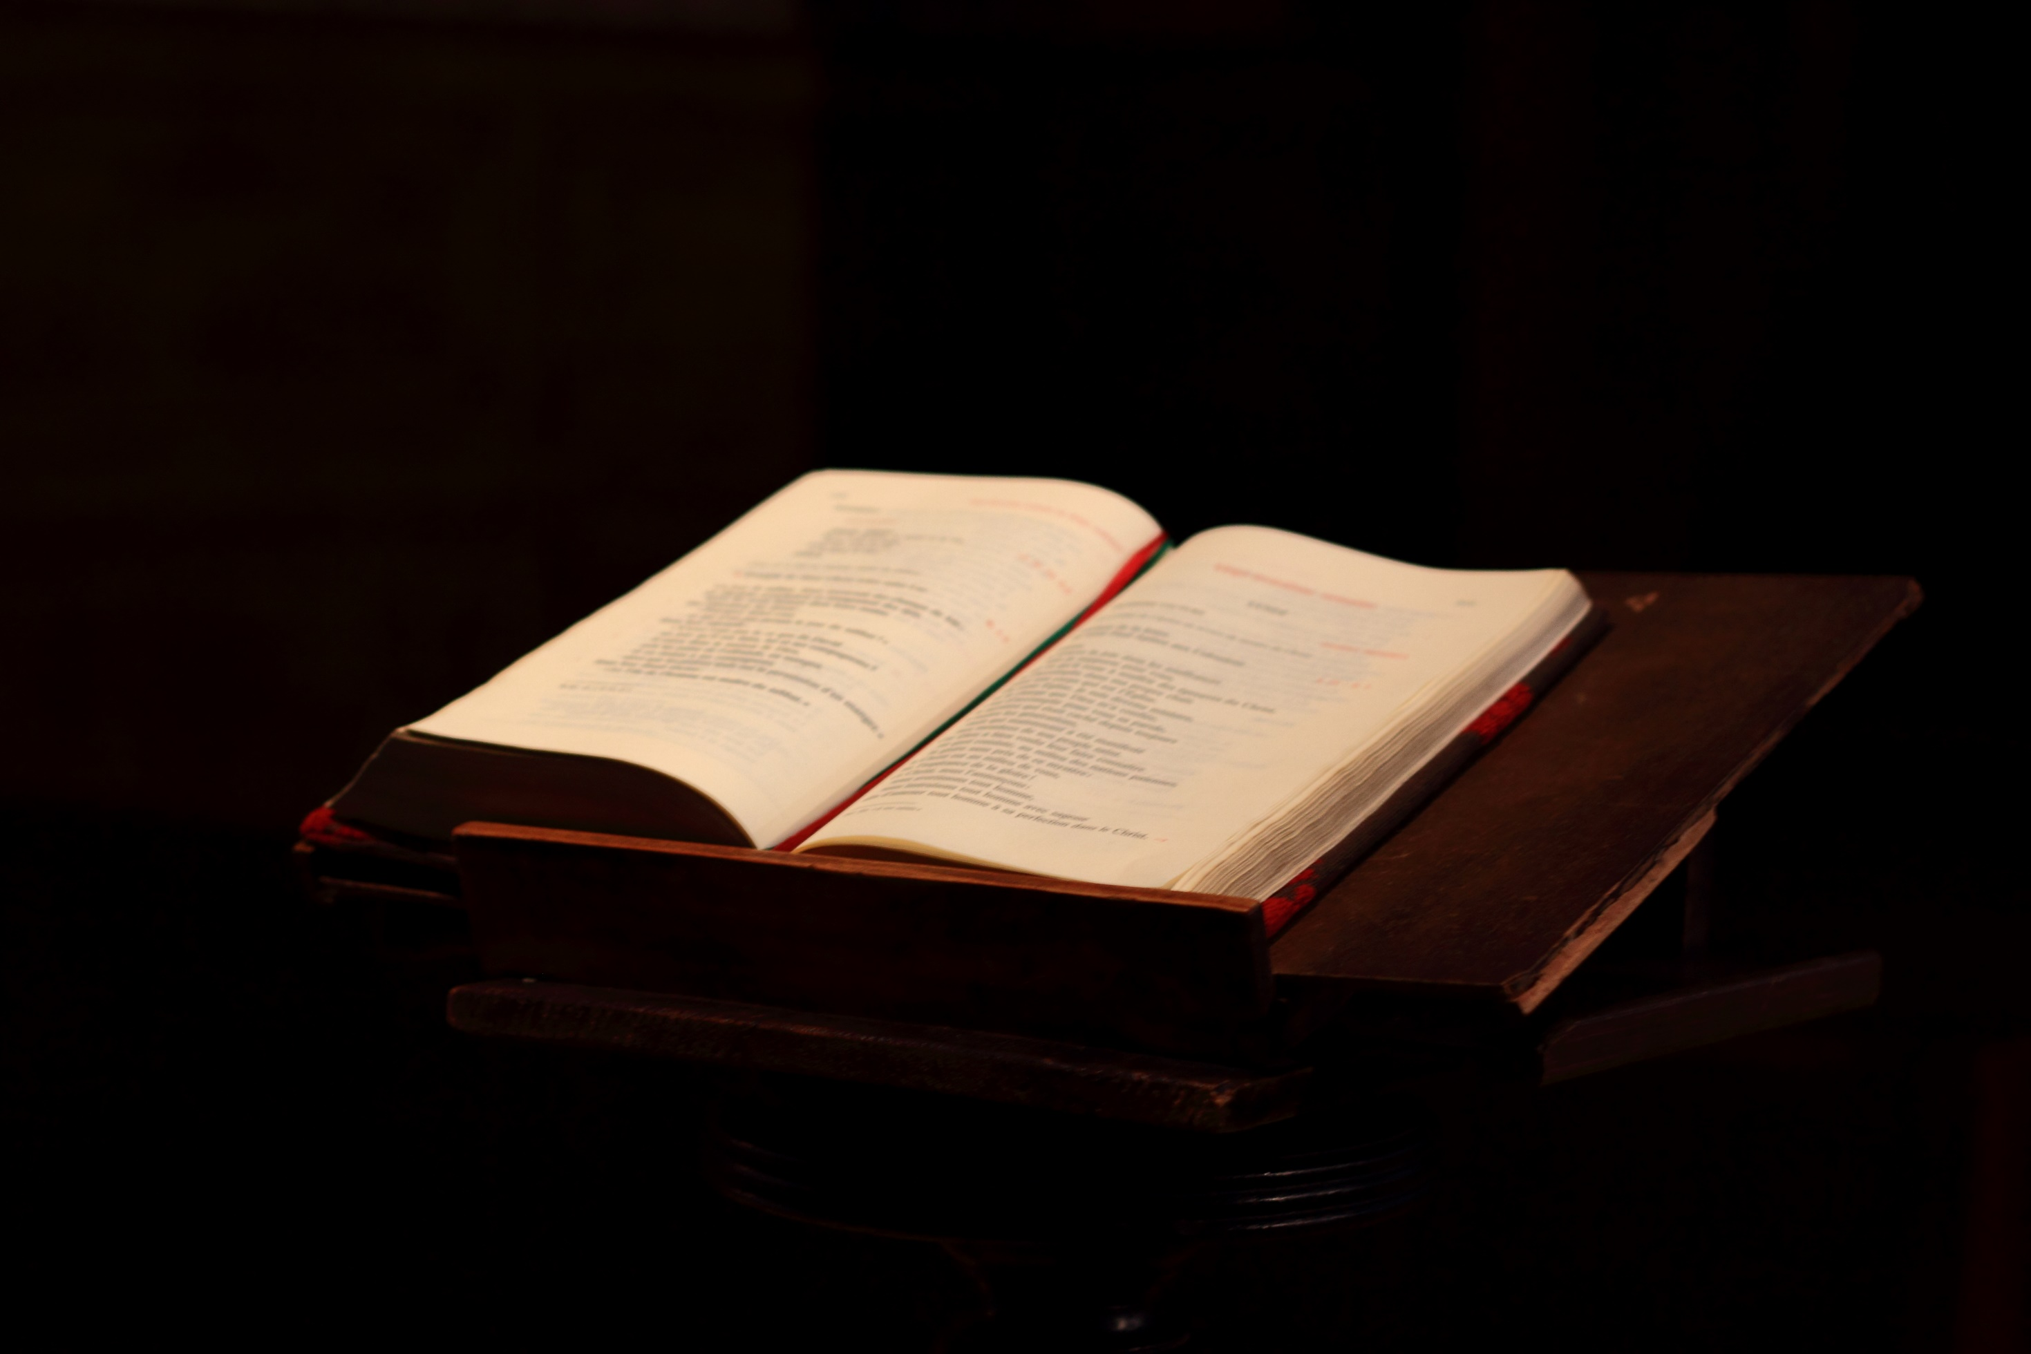
Thoroughly Equipped: Understanding Revelation (Pt 1)

Slide 4
John’s Revelation
A vision like the Old Testament prophecies
- In the Spirit on the Lord’s Day
- On the island of Patmos
- Seeing the Glorified Jesus
As Daniel saw Him in Daniel 10

Slide 5
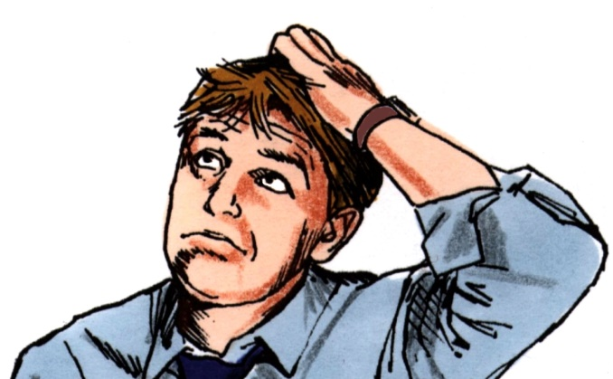
Thoroughly Abused
Pre-millennialism
End times theologians
Popular falsehoods
?
?

Slide 6
Difficult Passages
…Our beloved brother Paul, according to the wisdom given to him, has written to you, as also in all his epistles, speaking in them of these things, in which are some things hard to understand, which untaught and unstable people twist to their own destruction, as they do also the rest of the Scriptures. 2 Peter 3:15b-16

Slide 7
Difficult Passages
1. What is it NOT saying?
- Scriptures do not contradict
- Ruling out what is not the answer

Slide 8
Difficult Passages
1. What is it NOT saying?
2. Find the parallel passage
- Scriptures repeat ideas
- Look for words, terms, ideas

Slide 9
Difficult Passages
1. What is it NOT saying?
2. Find the parallel passage
3. Context is King
- Scriptures provide a context
- DO NOT PRESUPPOSE MEANING

Slide 10
Difficult Passages
1. What is it NOT saying?
2. Find the parallel passage
3. Context is King
4. Application is the ultimate goal
- How does this apply to you?

Slide 11
Keys to Revelation
The first verse is the most important
The 7 Churches teach an important lesson
Much of the vision is previous prophecy
Ezekiel
Daniel
Zechariah
Matthew 24

Slide 12
Keys to Revelation
The first verse is the most important
The 7 Churches teach an important lesson
Much of the vision is previous prophecy
The last portion is a teaching on:
Judgment
Hope
Notes:
Difficult people tend to be the best at identifying difficult people

Slide 13
Keys to Revelation
The first verse is the most important
The 7 Churches teach an important lesson
Much of the vision is previous prophecy
The last portion is a teaching on:
Notes:
Difficult people tend to be the best at identifying difficult people

Slide 14
Keys to Revelation
The first verse is the most important
The 7 Churches teach an important lesson
Much of the vision is previous prophecy
The last portion is a teaching on:
CONTEXT
Notes:
Difficult people tend to be the best at identifying difficult people

Slide 15
Keys to Revelation
The first verse is the most important
The 7 Churches teach an important lesson
Much of the vision is previous prophecy
The last portion is a teaching on:
CONTEXT
APPLICATION
Notes:
Difficult people tend to be the best at identifying difficult people

Slide 16
Keys to Revelation
The first verse is the most important
The 7 Churches teach an important lesson
Much of the vision is previous prophecy
The last portion is a teaching on:
CONTEXT
APPLICATION
PARALLEL PASSAGES
Notes:
Difficult people tend to be the best at identifying difficult people

Slide 17
Keys to Revelation
The first verse is the most important
The 7 Churches teach an important lesson
Much of the vision is previous prophecy
The last portion is a teaching on:
CONTEXT
APPLICATION
PARALLEL PASSAGES
APPLICATION
Notes:
Difficult people tend to be the best at identifying difficult people

Slide 18
The First Verse
The Revelation of Jesus Christ, which God gave Him to show His servants--things which must shortly take place. Revelation 1:1a
Notes:
Difficult people tend to be the best at identifying difficult people

Slide 19
The First Verse
The Revelation of Jesus Christ, which God gave Him to show His servants--things which must shortly take place. Revelation 1:1a
Notes:
Difficult people tend to be the best at identifying difficult people

Slide 20
The First Verse
1:1 – shortly take place
1:3 – the time is near
22:6 – shortly take place
22:7 – I am coming quickly
22:10 – the time is at hand
22:12 – I am coming quickly
22:20 – I am coming quickly
Notes:
Difficult people tend to be the best at identifying difficult people

Slide 21
Lesson of the 7 Churches
Churches can be cut off by Jesus:
For failing in love
For tolerating sin
For not being sound
For losing their divine purposes
Notes:
Difficult people tend to be the best at identifying difficult people

Slide 22
Lesson of the 7 Churches
Churches are not cut off for:
Going through trials and tribulations
Being small
Struggling
Being intolerant
Notes:
Difficult people tend to be the best at identifying difficult people

Slide 23
Prophecy
Revelation is a restatement of OT prophecy
Ezekiel – end of Judah, the new Temple
Zechariah – God’s wrath on Jerusalem
Daniel – victory over the nations

Slide 24
Prophecy
Revelation is a restatement of OT prophecy
Prophetic principles apply
Numbers are generally symbolic
Even today numbers have symbolism
3, 7, 12, 40, 1000 all have symbolism

Slide 25
Prophecy
Revelation is a restatement of OT prophecy
Prophetic principles apply
Numbers are generally symbolic
No symbol to image consistency
Example: Joel 2 and Acts 2

Slide 26
Prophecy
Revelation is a restatement of OT prophecy
Prophetic principles apply
Numbers are generally symbolic
No symbol to image consistency
Design: so when events occur we know

Slide 27
Revisiting Prophecy
Revelation 4-5 visits heaven
Restating Ezekiel 1-4
Revelation 6-9 and the end of Jerusalem
Restating Matthew 24
Restating Zechariah
Revelation 12-17
Restating Daniel 7

Slide 28
Revisiting Prophecy
Revelation 4-5 visits heaven
Restating Ezekiel 1-4

Slide 29
A View of Heaven (4-5)
John Saw | Ezekiel Saw
A door opened in Heaven | Heavens opened and with visions of God
Flashes of lightning | A cloud with lightning
4 living creatures | 4 living beings with human form:
Had many eyes, each with 6 wings | 4 faces and four wings
Face of a man, a bull, an eagle, a lion | Face of a lion, a man, eagle and bull
7 lamps of fire | Among them were fires darting around
7 lamps of fire = 7 Spirits of God | Each creature followed a Spirit
Something like a sea of crystal | A great expanse of something like crystal
A sound like thunder | A loud rushing noise like abundant waters
The Throne of Jasper and Sardius | The Throne appeared of Lapus Lazuli
A rainbow like an emerald at the throne | Radiance like a rainbow

Slide 30
A View of Heaven (4-5)
Rainbow – sign of a covenant (Gen. 9:13)
The One in Heaven – God (1 Tim. 6:16)
24 elders – Old Covenant, New Covenant
12 Apostles of Christ
12 Sons of Jacob

Slide 31
A View of Heaven (4-5)
Rainbow – sign of a covenant (Gen. 9:13)
The One in Heaven – God (1 Tim. 6:16)
24 elders – Old Covenant, New Covenant
7 Spirits of God – Knowledge (Isa. 11:2)
The 7 Seals – all authority (Matt. 28:18)

Slide 32
Preparing For What is Ahead
Revelation will continue with several messages
1. Those who persecute Christians
“Synagogue of Satan”
Those who claim to be Jews but are not
2. Those who persecute Christians
“Throne of Satan”
The Roman beast

Slide 33
What We Need to Know
1. Churches need to be sound:
In doctrine
In love
In membership
In worship
…… or lose their lampstand

Slide 34
What We Need to Know
1. Churches need to be sound:
2. We need to apply principles to Scriptures
- Not be ignorant of other passages
- Not distort their meaning

Slide 36
Your Garment
"Behold, I am coming as a thief. Blessed is he who watches, and keeps his garments, lest he walk naked and they see his shame.“ Revelation 16:15

Slide 37
Your Garment
"Behold, I am coming as a thief. Blessed is he who watches, and keeps his garments, lest he walk naked and they see his shame.“ Revelation 16:15
The Day of Judgment

Slide 38
Your Garment
"Behold, I am coming as a thief. Blessed is he who watches, and keeps his garments, lest he walk naked and they see his shame.“ Revelation 16:15
For all of you who were baptized into Christ have clothed yourselves with Christ Galatians 3:27

Slide 39
Your Garment
"Behold, I am coming as a thief. Blessed is he who watches, and keeps his garments, lest he walk naked and they see his shame.“ Revelation 16:15
But put on the Lord Jesus Christ, and make no provision for the flesh, to fulfill its lusts. Romans 13:14

